Slide 1


Backpropagation

Slide 2
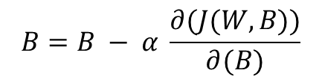
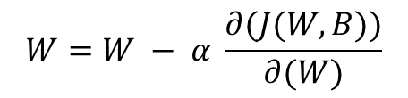
Backpropogation
Following are the steps:
Initialize weights randomly
Compute the Cost Function
Compute the gradient
Update the weights
$$W=W − α \frac{∂(J(W,B))}{∂(W)}$$
$$B=B − α \frac{∂(J(W,B))}{∂(B)}$$

Slide 3
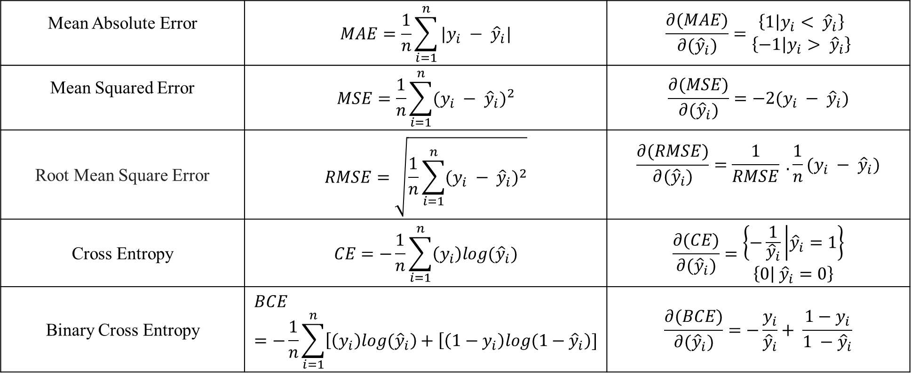
Derivatives of Cost Function
Mean Absolute Error | $$MAE=\frac{1}{n}\sum_{i=1}^{n}{|y_{i} − {\hat{y}}_{i}|}$$ | $$\frac{∂(MAE)}{∂({\hat{y}}_{i})}=\begin{aligned}\left\{1 | y_{i}< {\hat{y}}_{i}\right\} \\ \left\{−1 | y_{i}> {\hat{y}}_{i}\right\}\end{aligned}$$
Mean Squared Error | $$MSE=\frac{1}{n}\sum_{i=1}^{n}{{(y_{i} − {\hat{y}}_{i})}^{2}}$$ | $$\frac{∂(MSE)}{∂({\hat{y}}_{i})}=−2(y_{i} − {\hat{y}}_{i})$$
Root Mean Square Error | $$RMSE=\sqrt{\frac{1}{n}\sum_{i=1}^{n}{{(y_{i} − {\hat{y}}_{i})}^{2}}}$$ | $$\frac{∂(RMSE)}{∂({\hat{y}}_{i})}=\frac{1}{RMSE} . \frac{1}{n}(y_{i} − {\hat{y}}_{i})$$
Cross Entropy | $$CE=−\frac{1}{n}\sum_{i=1}^{n}{\left(y_{i}\right)log{(\hat{y}}_{i})}$$ | $$\frac{∂(CE)}{∂({\hat{y}}_{i})}=\begin{aligned}\left\{−\frac{1}{{\hat{y}}_{i}} | {\hat{y}}_{i}=1\right\} \\ \left\{0 | {\hat{y}}_{i}=0\right\}\end{aligned}$$
Binary Cross Entropy | $$BCE=−\frac{1}{n}\sum_{i=1}^{n}{\left[\left(y_{i}\right)log{(\hat{y}}_{i}\right)+\left[\left(1−y_{i}\right)log{(1−\hat{y}}_{i}\right)]}$$ | $$\frac{∂(BCE)}{∂({\hat{y}}_{i})}=−\frac{y_{i}}{{\hat{y}}_{i}}+ \frac{1−y_{i}}{1 −{\hat{y}}_{i}}$$

Slide 4










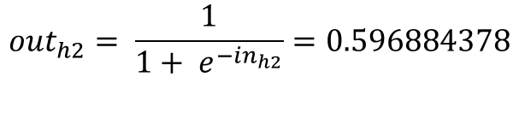






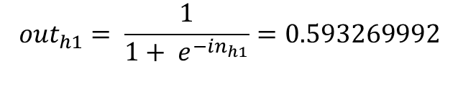

























Forward Pass Layer 1
$$h_{1}$$
$in_{h1}= w_{1}i_{1}+w_{2}i_{2}$ + $b_{1}=0.3775$
$$o_{1}$$
$$w_{1}$$
$$w_{5}$$
$in_{h2}= w_{3}i_{1}+w_{4}i_{2}$ + $b_{1}=0.3925$
$$i_{1}$$
$$in_{h1}$$
$${out}_{h1}$$
$$in_{o1}$$
$${out}_{o1}$$
$$i_{1}$$
$$w_{2}$$
$$w_{6}$$
$$0.01$$
$$w_{3}$$
$$h_{2}$$
$$o_{2}$$
$$w_{7}$$
$$0.99$$
$${out}_{h1}= \frac{1}{1+ e^{−in_{h1}}}=0.593269992$$
$$i_{2}$$
$$in_{h2}$$
$${out}_{h2}$$
$$in_{o2}$$
$${out}_{o2}$$
$$w_{4}$$
$$w_{8}$$
$${out}_{h2}= \frac{1}{1+ e^{−in_{h2}}}=0.596884378$$
$$B_{1}$$
$$B_{2}$$
$$i_{1}=0.05$$
$$w_{1}=0.15$$
$$w_{2}=0.20$$
$$w_{3}=0.25$$
$$w_{4}=0.30$$
$$B_{1}=0.35$$
$$i_{2}=0.10$$
$$w_{5}=0.40$$
$$w_{6}=0.45$$
$$w_{7}=0.50$$
$$w_{8}=0.55$$
$$B_{2}=0.60$$

Slide 5


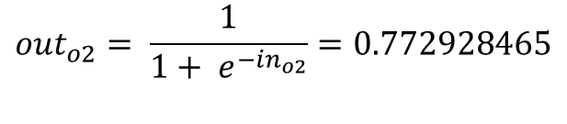
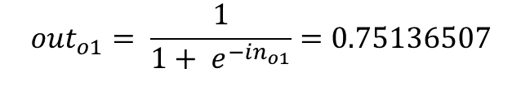

Forward Pass Layer 2
$$h_{1}$$
$$o_{1}$$
$$w_{1}$$
$$w_{5}$$
$in_{o1}= w_{5}{out}_{h1}+w_{6}{out}_{h2}$ + $b_{2}=1.105905967$
$$i_{1}$$
$$in_{h1}$$
$${out}_{h1}$$
$$in_{o1}$$
$${out}_{o1}$$
$$i_{1}$$
$$w_{2}$$
$$w_{6}$$
$$0.01$$
$in_{o2}= w_{7}{out}_{h1}+w_{8}{out}_{h2}$ + $b_{2}=1.224921404$
$$h_{2}$$
$$o_{2}$$
$$w_{3}$$
$$w_{7}$$
$$0.99$$
$$in_{h2}$$
$$in_{o2}$$
$${out}_{o2}$$
$${out}_{o1}= \frac{1}{1+ e^{−in_{o1}}}=0.75136507$$
$$i_{2}$$
$${out}_{h2}$$
$$w_{8}$$
$$w_{4}$$
$$B_{1}$$
$$B_{2}$$
$${out}_{o2}= \frac{1}{1+ e^{−{in}_{o2}}}=0.772928465$$

Slide 6

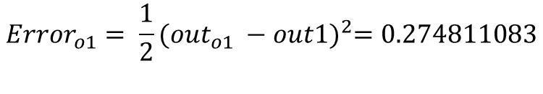

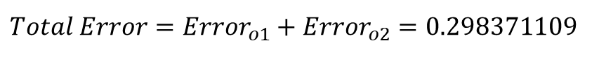
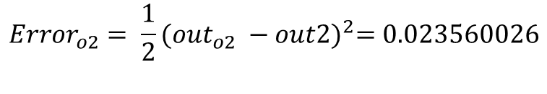
Forward Pass Error (Cost Function)
$$h_{1}$$
$$o_{1}$$
$${Error}_{o1}= \frac{1}{2}{({out}_{o1} −out1)}^{2}=0.274811083$$
$$w_{1}$$
$$w_{5}$$
$$i_{1}$$
$$in_{h1}$$
$${out}_{h1}$$
$$in_{o1}$$
$${out}_{o1}$$
$$i_{1}$$
$$w_{2}$$
$$w_{6}$$
$$0.01$$
$${Error}_{o2}= \frac{1}{2}{({out}_{o2} −out2)}^{2}=0.023560026$$
$$h_{2}$$
$$o_{2}$$
$$w_{3}$$
$$w_{7}$$
$$0.99$$
$$i_{2}$$
$$in_{h2}$$
$${out}_{h2}$$
$$in_{o2}$$
$${out}_{o2}$$
$$Total Error={Error}_{o1}+{Error}_{o2}=0.298371109$$
$$w_{4}$$
$$w_{8}$$
$$B_{1}$$
$$B_{2}$$

Slide 7
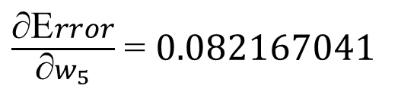


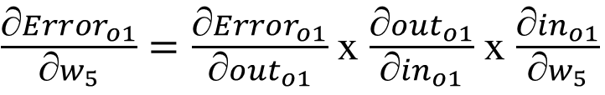

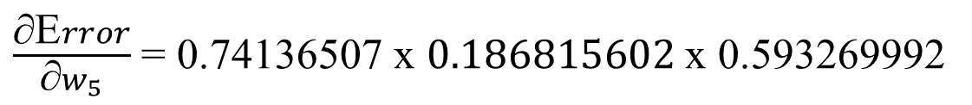
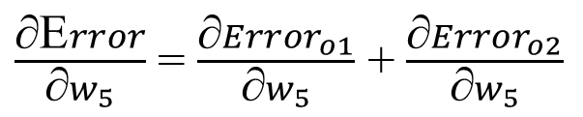



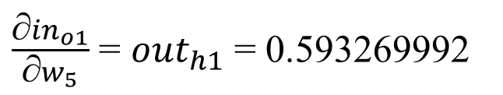

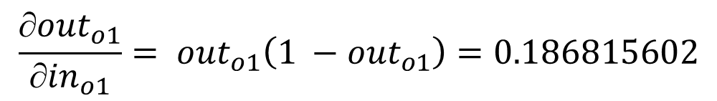

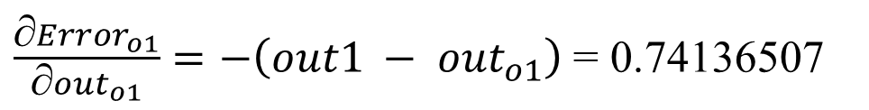

$\frac{\text{∂}{Error}_{o1}}{\text{∂}w_{5}}=\frac{\text{∂}{Error}_{o1}}{\text{∂}{out}_{o1}}$ x $\frac{\text{∂}{out}_{o1}}{\text{∂}{in}_{o1}}$ x $\frac{\text{∂}{in}_{o1}}{\text{∂}w_{5}}$
Backpropagation
$$o_{1}$$
$\frac{\text{∂}{Error}_{o1}}{\text{∂}{out}_{o1}}=−\left({out1 − out}_{o1}\right)$ = 0.74136507
$$w_{5}$$
$$in_{o1}$$
$${out}_{o1}$$
$$0.01$$
$$\frac{\text{∂}{out}_{o1}}{\text{∂}{in}_{o1}}= {out}_{o1}\left(1 −{out}_{o1}\right)=0.186815602$$
Error
$$o_{2}$$
$$0.99$$
$$in_{o2}$$
$${out}_{o2}$$
$\frac{\text{∂}{in}_{o1}}{\text{∂}w_{5}}$ = ${out}_{h1}$ = 0.593269992
$\frac{\text{∂}\text{E}rror}{\text{∂}w_{5}}$ = $\frac{\text{∂}{Error}_{o1}}{\text{∂}w_{5}}$ + $\frac{\text{∂}{Error}_{o2}}{\text{∂}w_{5}}$
$\frac{\text{∂}\text{E}rror}{\text{∂}w_{5}}$ = 0.74136507 x $0.186815602$ x 0.593269992
$\frac{\text{∂}\text{E}rror}{\text{∂}w_{5}}$ = 0.082167041

Slide 8
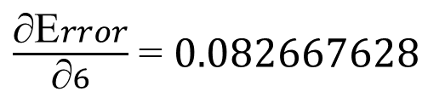

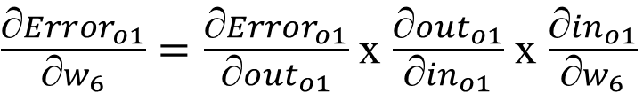
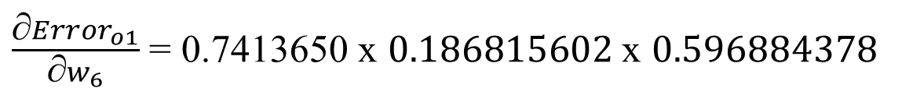
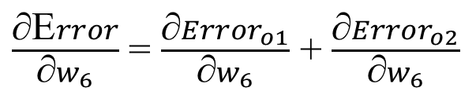

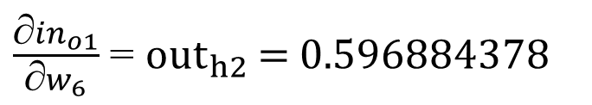
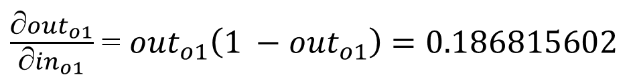
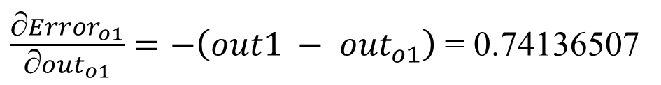
$\frac{\text{∂}{Error}_{o1}}{\text{∂}w_{6}}=\frac{\text{∂}{Error}_{o1}}{\text{∂}{out}_{o1}}$ x $\frac{\text{∂}{out}_{o1}}{\text{∂}{in}_{o1}}$ x $\frac{\text{∂}{in}_{o1}}{\text{∂}w_{6}}$
BackPropagation
$$o_{1}$$
$\frac{\text{∂}{Error}_{o1}}{\text{∂}{out}_{o1}}=−\left({out1 − out}_{o1}\right)$ = 0.74136507
$$in_{o1}$$
$${out}_{o1}$$
$$w_{6}$$
$$0.01$$
$\frac{\text{∂}{out}_{o1}}{\text{∂}{in}_{o1}}$ = ${out}_{o1}\left(1 −{out}_{o1}\right)=0.186815602$
Error
$$o_{2}$$
$$0.99$$
$$in_{o2}$$
$${out}_{o2}$$
$\frac{\text{∂}{in}_{o1}}{\text{∂}w_{6}}$ = ${out}_{h2}$ = 0.596884378
$\frac{\text{∂}\text{E}rror}{\text{∂}w_{6}}$ = $\frac{\text{∂}{Error}_{o1}}{\text{∂}w_{6}}$ + $\frac{\text{∂}{Error}_{o2}}{\text{∂}w_{6}}$
$\frac{\text{∂}{Error}_{o1}}{\text{∂}w_{6}}$ = 0.7413650 x $0.186815602$ x 0.596884378
$\frac{\text{∂}\text{E}rror}{\text{∂}6}$ = 0.082667628

Slide 9
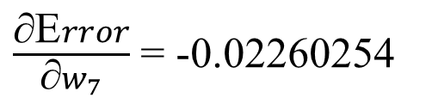
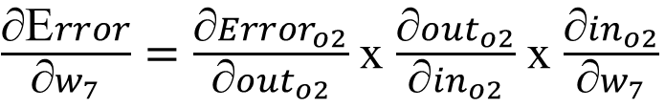
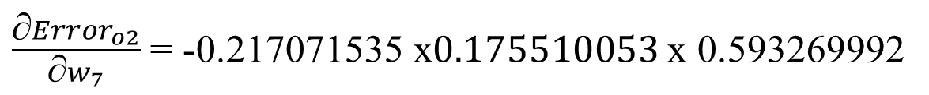

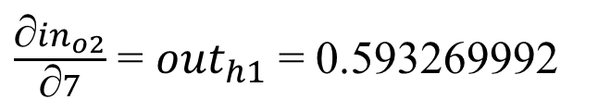
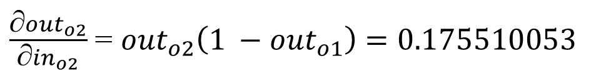
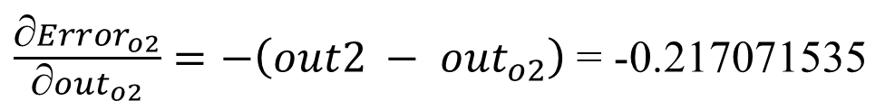
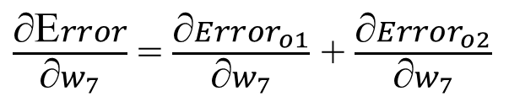

$\frac{\text{∂}\text{E}rror}{\text{∂}w_{7}}=\frac{\text{∂}{Error}_{o2}}{\text{∂}{out}_{o2}}$ x $\frac{\text{∂}{out}_{o2}}{\text{∂}{in}_{o2}}$ x $\frac{\text{∂}{in}_{o2}}{\text{∂}w_{7}}$
BackPropagation
$$o_{1}$$
$\frac{\text{∂}{Error}_{o2}}{\text{∂}{out}_{o2}}=−\left({out2 − out}_{o2}\right)$ = -0.217071535
$$in_{o1}$$
$${out}_{o1}$$
$$0.01$$
$\frac{\text{∂}{out}_{o2}}{\text{∂}{in}_{o2}}$ = ${out}_{o2}\left(1 −{out}_{o1}\right)=0.175510053$
Error
$$o_{2}$$
$$w_{7}$$
$$0.99$$
$$in_{o2}$$
$${out}_{o2}$$
$\frac{\text{∂}{in}_{o2}}{\text{∂}7}$ = ${out}_{h1}$ = 0.593269992
$\frac{\text{∂}{Error}_{o2}}{\text{∂}w_{7}}$ = -0.217071535 x$0.175510053$x 0.593269992
$\frac{\text{∂}\text{E}rror}{\text{∂}w_{7}}$ = $\frac{\text{∂}{Error}_{o1}}{\text{∂}w_{7}}$ + $\frac{\text{∂}{Error}_{o2}}{\text{∂}w_{7}}$
$\frac{\text{∂}\text{E}rror}{\text{∂}w_{7}}$ = -0.02260254

Slide 10
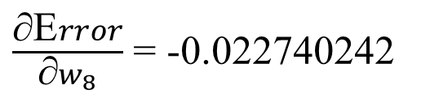


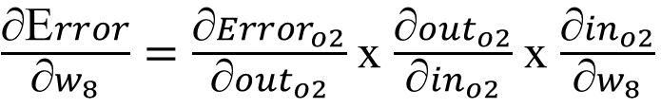
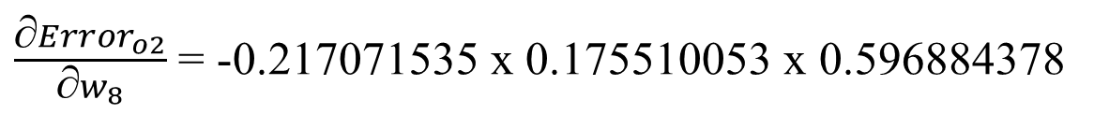



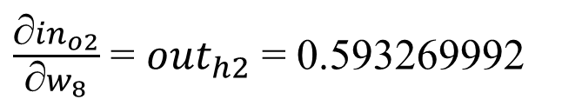

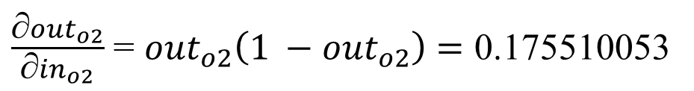


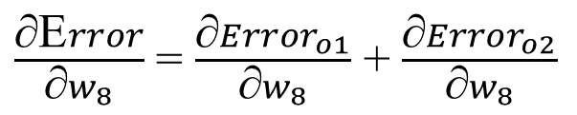

$\frac{\text{∂}\text{E}rror}{\text{∂}w_{8}}=\frac{\text{∂}{Error}_{o2}}{\text{∂}{out}_{o2}}$ x $\frac{\text{∂}{out}_{o2}}{\text{∂}{in}_{o2}}$ x $\frac{\text{∂}{in}_{o2}}{\text{∂}w_{8}}$
BackPropagation
$\frac{\text{∂}{Error}_{o2}}{\text{∂}{out}_{o2}}=−\left({out2 − out}_{o2}\right)$ = -0.217071535
$$o_{1}$$
$$in_{o1}$$
$${out}_{o1}$$
$$0.01$$
$\frac{\text{∂}{out}_{o2}}{\text{∂}{in}_{o2}}$ = ${out}_{o2}\left(1 −{out}_{o2}\right)=\text{0.175510053}$
Error
$$o_{2}$$
$$0.99$$
$$in_{o2}$$
$${out}_{o2}$$
$\frac{\text{∂}{in}_{o2}}{\text{∂}w_{8}}$ = ${out}_{h2}$ = 0.593269992
$$w_{8}$$
$\frac{\text{∂}{Error}_{o2}}{\text{∂}w_{8}}$ = -0.217071535 x 0.175510053 x 0.596884378
$\frac{\text{∂}\text{E}rror}{\text{∂}w_{8}}$ = $\frac{\text{∂}{Error}_{o1}}{\text{∂}w_{8}}$ + $\frac{\text{∂}{Error}_{o2}}{\text{∂}w_{8}}$
$\frac{\text{∂}\text{E}rror}{\text{∂}w_{8}}$ = -0.022740242

Slide 11
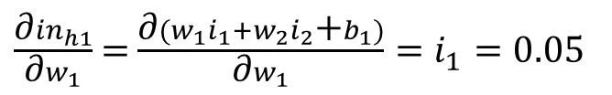


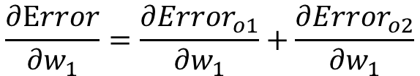

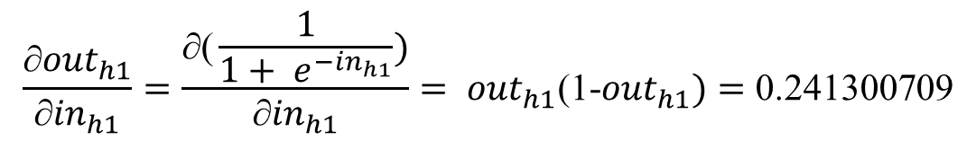




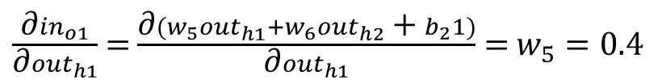

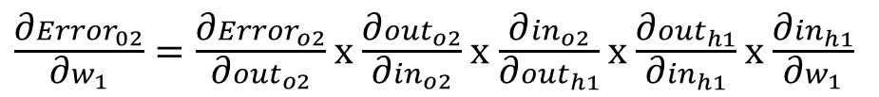




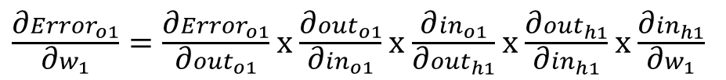


Already Computed
BackPropagation
$\frac{\text{∂}{Error}_{o1}}{\text{∂}w_{1}}=\frac{\text{∂}{Error}_{o1}}{\text{∂}{out}_{o1}}$ x $\frac{\text{∂}{out}_{o1}}{\text{∂}{in}_{o1}}$ x $\frac{\text{∂}{in}_{o1}}{\text{∂}{out}_{h1}}$ x $\frac{\text{∂}{out}_{h1}}{\text{∂}{in}_{h1}}$ x $\frac{\text{∂}{in}_{h1}}{\text{∂}w_{1}}$
$$h_{1}$$
$$o_{1}$$
$$w_{1}$$
$$w_{5}$$
$\frac{\text{∂}{Error}_{02}}{\text{∂}w_{1}}=\frac{\text{∂}{Error}_{o2}}{\text{∂}{out}_{o2}}$ x $\frac{\text{∂}{out}_{o2}}{\text{∂}{in}_{o2}}$ x $\frac{\text{∂}{in}_{o2}}{\text{∂}{out}_{h1}}$ x $\frac{\text{∂}{out}_{h1}}{\text{∂}{in}_{h1}}$ x $\frac{\text{∂}{in}_{h1}}{\text{∂}w_{1}}$
$$in_{h1}$$
$${out}_{h1}$$
$$in_{o1}$$
$${out}_{o1}$$
$$0.01$$
Error
$\frac{\text{∂}{in}_{o1}}{\text{∂}{out}_{h1}}$ = $\frac{\text{∂}(w_{5}{out}_{h1}+w_{6}{out}_{h2}\text{ + }b_{2}1)}{\text{∂}{out}_{h1}}$ = $w_{5}=\text{0.4}$
$$o_{2}$$
$$w_{7}$$
$$0.99$$
$$in_{o2}$$
$${out}_{o2}$$
$$\frac{\text{∂}{out}_{h1}}{\text{∂}{in}_{h1}}=\frac{\text{∂}\text{(}\frac{1}{1+ e^{−in_{h1}}})}{\text{∂}{in}_{h1}}= {{out}_{h1}\text{(1−}out}_{h1})=\text{0.241300709}$$
$$\frac{\text{∂}\text{E}rror}{\text{∂}w_{1}}=\frac{\text{∂}{Error}_{o1}}{\text{∂}w_{1}}+\frac{\text{∂}{Error}_{o2}}{\text{∂}w_{1}}$$
$\frac{\text{∂}{in}_{h1}}{\text{∂}w_{1}}$ = $\frac{\text{∂}(w_{1}i_{1}+w_{2}i_{2}\text{+}b_{1})}{\text{∂}w_{1}}=i_{1}=0.05$
$\frac{\text{∂}{Error}_{o1}}{\text{∂}w_{1}}$ = 0.74136507 x 0.186815602 x $\text{0.4 }$x $\text{0.241300709 }\text{x}\text{ 0.05 = 0.000668}$

Slide 12


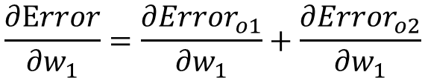





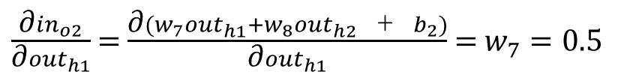

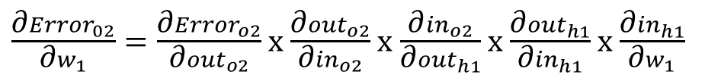



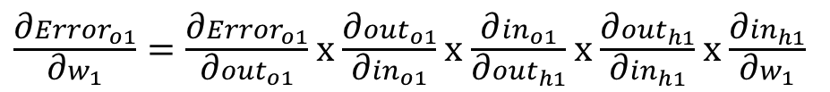



$$\frac{\text{∂}\text{E}rror}{\text{∂}w_{1}}=\frac{\text{∂}{Error}_{o1}}{\text{∂}w_{1}}+\frac{\text{∂}{Error}_{o2}}{\text{∂}w_{1}}$$
BackPropagation
Already Computed
$$h_{1}$$
$$o_{1}$$
$$w_{1}$$
$$w_{5}$$
$$in_{h1}$$
$${out}_{h1}$$
$$in_{o1}$$
$${out}_{o1}$$
$\frac{\text{∂}{Error}_{o1}}{\text{∂}w_{1}}=\frac{\text{∂}{Error}_{o1}}{\text{∂}{out}_{o1}}$ x $\frac{\text{∂}{out}_{o1}}{\text{∂}{in}_{o1}}$ x $\frac{\text{∂}{in}_{o1}}{\text{∂}{out}_{h1}}$ x $\frac{\text{∂}{out}_{h1}}{\text{∂}{in}_{h1}}$ x $\frac{\text{∂}{in}_{h1}}{\text{∂}w_{1}}$
$$0.01$$
$\frac{\text{∂}{Error}_{02}}{\text{∂}w_{1}}=\frac{\text{∂}{Error}_{o2}}{\text{∂}{out}_{o2}}$ x $\frac{\text{∂}{out}_{o2}}{\text{∂}{in}_{o2}}$ x $\frac{\text{∂}{in}_{o2}}{\text{∂}{out}_{h1}}$ x $\frac{\text{∂}{out}_{h1}}{\text{∂}{in}_{h1}}$ x $\frac{\text{∂}{in}_{h1}}{\text{∂}w_{1}}$
Error
$$o_{2}$$
$$w_{7}$$
$$0.99$$
$$in_{o2}$$
$${out}_{o2}$$
$\frac{\text{∂}{in}_{o2}}{\text{∂}{out}_{h1}}$ = $\frac{\text{∂}(w_{7}{out}_{h1}+w_{8}{out}_{h2}\text{ + }b_{2})}{\text{∂}{out}_{h1}}$ = $w_{7}=\text{0.}\text{5}$
$\frac{\text{∂}{Error}_{o2}}{\text{∂}w_{1}}$ = -0.217071535 x 0.175510053 x $\text{0.}\text{5}$x $\text{0.241300709 }\text{x}\text{ 0.05 =−0.000229828}$
$\frac{\text{∂}\text{E}rror}{\text{∂}w_{1}}= \frac{\text{∂}{Error}_{o1}}{\text{∂}w_{1}}+\frac{\text{∂}{Error}_{o2}}{\text{∂}w_{1}}\text{=}\text{0.000438568} +( − \text{0.000229828}\text{)}$ = 0.000438568

Slide 13


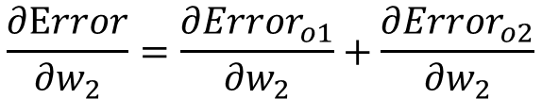





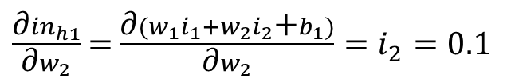

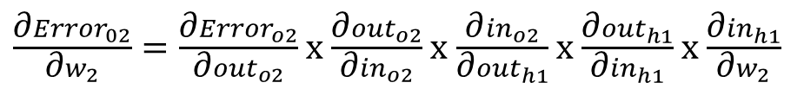







$$\frac{\text{∂}\text{E}rror}{\text{∂}w_{2}}=\frac{\text{∂}{Error}_{o1}}{\text{∂}w_{2}}+\frac{\text{∂}{Error}_{o2}}{\text{∂}w_{2}}$$
BackPropagation
Already Computed
$$h_{1}$$
$$o_{1}$$
$\frac{\text{∂}{Error}_{o1}}{\text{∂}w_{2}}=\frac{\text{∂}{Error}_{o1}}{\text{∂}{out}_{o1}}$ x $\frac{\text{∂}{out}_{o1}}{\text{∂}{in}_{o1}}$ x $\frac{\text{∂}{in}_{o1}}{\text{∂}{out}_{h1}}$ x $\frac{\text{∂}{out}_{h1}}{\text{∂}{in}_{h1}}$ x $\frac{\text{∂}{in}_{h1}}{\text{∂}w_{2}}$
$$w_{5}$$
$$in_{h1}$$
$${out}_{h1}$$
$$in_{o1}$$
$${out}_{o1}$$
$$w_{2}$$
$$w_{6}$$
$$0.01$$
$\frac{\text{∂}{Error}_{02}}{\text{∂}w_{2}}=\frac{\text{∂}{Error}_{o2}}{\text{∂}{out}_{o2}}$ x $\frac{\text{∂}{out}_{o2}}{\text{∂}{in}_{o2}}$ x $\frac{\text{∂}{in}_{o2}}{\text{∂}{out}_{h1}}$ x $\frac{\text{∂}{out}_{h1}}{\text{∂}{in}_{h1}}$ x $\frac{\text{∂}{in}_{h1}}{\text{∂}w_{2}}$
Error
$$o_{2}$$
$\frac{\text{∂}{in}_{h1}}{\text{∂}w_{2}}$ = $\frac{\text{∂}(w_{1}i_{1}+w_{2}i_{2}\text{+}b_{1})}{\text{∂}w_{2}}=i_{2}=0.1$
$$0.99$$
$$in_{o2}$$
$${out}_{o2}$$
$\frac{\text{∂}{Error}_{o1}}{\text{∂}w_{2}}$ = 0.74136507 x 0.186815602 x $\text{0.4 }$x $\text{0.241300709 }\text{x}\text{ 0.1 =0.001336792}$
$\frac{\text{∂}{Error}_{o2}}{\text{∂}w_{2}}$ = -0.217071535 x 0.175510053 x $\text{0.}\text{5}$x $\text{0.241300709 }\text{x}\text{ 0.1 = −0.000367725}$
$$\frac{\text{∂}Error}{\text{∂}w_{2}}= \frac{\text{∂}{Error}_{o1}}{\text{∂}w_{2}}+\frac{\text{∂}{Error}_{o2}}{\text{∂}w_{2}}\text{= }\text{0.001336792}+(\text{−0.000367725)}\text{= 0.000969067}$$

Slide 14




















$$\frac{\text{∂}\text{E}rror}{\text{∂}w_{3}}=\frac{\text{∂}{Error}_{o1}}{\text{∂}w_{3}}+\frac{\text{∂}{Error}_{o2}}{\text{∂}w_{3}}$$
BackPropagation
Already Computed
$\frac{\text{∂}{Error}_{o1}}{\text{∂}w_{3}}=\frac{\text{∂}{Error}_{o1}}{\text{∂}{out}_{o1}}$ x $\frac{\text{∂}{out}_{o1}}{\text{∂}{in}_{o1}}$ x $\frac{\text{∂}{in}_{o1}}{\text{∂}{out}_{h2}}$ x $\frac{\text{∂}{out}_{h2}}{\text{∂}{in}_{h2}}$ x $\frac{\text{∂}{in}_{h2}}{\text{∂}w_{3}}$
$$o_{1}$$
$$in_{o1}$$
$${out}_{o1}$$
$$w_{6}$$
$$0.01$$
$\frac{\text{∂}{Error}_{02}}{\text{∂}w_{3}}=\frac{\text{∂}{Error}_{o2}}{\text{∂}{out}_{o2}}$ x $\frac{\text{∂}{out}_{o2}}{\text{∂}{in}_{o2}}$ x $\frac{\text{∂}{in}_{o2}}{\text{∂}{out}_{h2}}$ x $\frac{\text{∂}{out}_{h2}}{\text{∂}{in}_{h2}}$ x $\frac{\text{∂}{in}_{h2}}{\text{∂}w_{3}}$
Error
$\frac{\text{∂}{in}_{o1}}{\text{∂}{out}_{h2}}$ = $\frac{\text{∂}(w_{5}{out}_{h1}+w_{6}{out}_{h2}\text{ + }b_{2}1)}{\text{∂}{out}_{h2}}$ = $w_{6}=\text{0.4}\text{5}$
$$h_{2}$$
$$o_{2}$$
$$w_{3}$$
$$0.99$$
$$\frac{\text{∂}{out}_{h2}}{\text{∂}{in}_{h2}}=\frac{\text{∂(}\frac{1}{1+ e^{−in_{h2}}})}{\text{∂}{in}_{h2}}= {{out}_{h2}\text{(1−}out}_{h2})=\text{0.240613417}$$
$$in_{h2}$$
$${out}_{h2}$$
$$in_{o2}$$
$${out}_{o2}$$
$$w_{8}$$
$\frac{\text{∂}{in}_{h2}}{\text{∂}w_{3}}$ = $\frac{\text{∂}(w_{3}i_{1}+w_{4}i_{2}\text{+}b_{1})}{\text{∂}w_{1}}=i_{1}=0.05$
$\frac{\text{∂}{Error}_{o1}}{\text{∂}w_{3}}$ = 0.74136507 x 0.186815602 x $\text{0.4}\text{5}$x $\text{0.240613417 }\text{x}\text{ 0.05 =0.000749804}$

Slide 15


















$$\frac{\text{∂}\text{E}rror}{\text{∂}w_{3}}=\frac{\text{∂}{Error}_{o1}}{\text{∂}w_{3}}+\frac{\text{∂}{Error}_{o2}}{\text{∂}w_{3}}$$
BackPropagation
Already Computed
$$o_{1}$$
$$in_{o1}$$
$${out}_{o1}$$
$\frac{\text{∂}{Error}_{o1}}{\text{∂}w_{3}}=\frac{\text{∂}{Error}_{o1}}{\text{∂}{out}_{o1}}$ x $\frac{\text{∂}{out}_{o1}}{\text{∂}{in}_{o1}}$ x $\frac{\text{∂}{in}_{o1}}{\text{∂}{out}_{h2}}$ x $\frac{\text{∂}{out}_{h2}}{\text{∂}{in}_{h2}}$ x $\frac{\text{∂}{in}_{h2}}{\text{∂}w_{3}}$
$$w_{6}$$
$$0.01$$
$\frac{\text{∂}{Error}_{02}}{\text{∂}w_{3}}=\frac{\text{∂}{Error}_{o2}}{\text{∂}{out}_{o2}}$ x $\frac{\text{∂}{out}_{o2}}{\text{∂}{in}_{o2}}$ x $\frac{\text{∂}{in}_{o2}}{\text{∂}{out}_{h2}}$ x $\frac{\text{∂}{out}_{h2}}{\text{∂}{in}_{h2}}$ x $\frac{\text{∂}{in}_{h2}}{\text{∂}w_{3}}$
Error
$$h_{2}$$
$$o_{2}$$
$$w_{3}$$
$$0.99$$
$\frac{\text{∂}{in}_{o2}}{\text{∂}{out}_{h2}}$ = $\frac{\text{∂}(w_{7}{out}_{h1}+w_{8}{out}_{h2}\text{ + }b_{2})}{\text{∂}{out}_{h2}}$ =$w_{8}=\text{0.}\text{55}$
$$in_{h2}$$
$${out}_{h2}$$
$$in_{o2}$$
$${out}_{o2}$$
$$w_{8}$$
$\frac{\text{∂}{Error}_{o2}}{\text{∂}w_{3}}$ = -0.217071535 x 0.175510053 x $\text{0.}\text{55}$x $\text{0.240613417 }\text{x}\text{ 0.05 =−0.000252091}$
$\frac{\text{∂}\text{E}rror}{\text{∂}w_{3}}= \frac{\text{∂}{Error}_{o1}}{\text{∂}w_{3}}+\frac{\text{∂}{Error}_{o2}}{\text{∂}w_{3}}\text{=}\text{0.000749804}+(\text{−0.000252091)}$ = 0.000497713

Slide 16


















$$\frac{\text{∂}\text{E}rror}{\text{∂}w_{4}}=\frac{\text{∂}{Error}_{o1}}{\text{∂}w_{4}}+\frac{\text{∂}{Error}_{o2}}{\text{∂}w_{4}}$$
BackPropagation
Already Computed
$$o_{1}$$
$$in_{o1}$$
$${out}_{o1}$$
$\frac{\text{∂}{Error}_{o1}}{\text{∂}w_{4}}=\frac{\text{∂}{Error}_{o1}}{\text{∂}{out}_{o1}}$ x $\frac{\text{∂}{out}_{o1}}{\text{∂}{in}_{o1}}$ x $\frac{\text{∂}{in}_{o1}}{\text{∂}{out}_{h2}}$ x $\frac{\text{∂}{out}_{h2}}{\text{∂}{in}_{h2}}$ x $\frac{\text{∂}{in}_{h2}}{\text{∂}w_{4}}$
$$0.01$$
$$w_{6}$$
$\frac{\text{∂}{Error}_{02}}{\text{∂}w_{4}}=\frac{\text{∂}{Error}_{o2}}{\text{∂}{out}_{o2}}$ x $\frac{\text{∂}{out}_{o2}}{\text{∂}{in}_{o2}}$ x $\frac{\text{∂}{in}_{o2}}{\text{∂}{out}_{h2}}$ x $\frac{\text{∂}{out}_{h2}}{\text{∂}{in}_{h2}}$ x $\frac{\text{∂}{in}_{h2}}{\text{∂}w_{4}}$
Error
$$h_{2}$$
$$o_{2}$$
$$0.99$$
$$in_{h2}$$
$${out}_{h2}$$
$$in_{o2}$$
$${out}_{o2}$$
$\frac{\text{∂}{in}_{h2}}{\text{∂}w_{4}}$ = $\frac{\text{∂}(w_{3}i_{1}+w_{4}i_{2}\text{+}b_{1})}{\text{∂}w_{2}}=i_{2}=0.1$
$$w_{4}$$
$$w_{8}$$
$\frac{\text{∂}{Error}_{o2}}{\text{∂}w_{4}}$ -0.217071535 x 0.175510053 x $\text{0.}\text{55}$x $\text{0.240613417 }\text{x}\text{ 0.1 =−0.00050418}\text{2}$
$\frac{\text{∂}{Error}_{o1}}{\text{∂}w_{4}}$ = 0.74136507 x 0.186815602 x $\text{0.4}\text{5}$x $\text{0.240613417 }\text{x}\text{ 0.1 =0.001499608}$
$\frac{\text{∂}\text{E}rror}{\text{∂}w_{4}}= \frac{\text{∂}{Error}_{o1}}{\text{∂}w_{4}}+\frac{\text{∂}{Error}_{o2}}{\text{∂}w_{4}}\text{=}\text{0.001499608}+(\text{−0.000504182}\text{)}$ = 0.000995425

Slide 17








$\frac{\text{∂}\text{E}rror}{\text{∂}w_{5}}$ = 0.082167041
$\frac{\text{∂}\text{E}rror}{\text{∂}w_{1}}=$0.000438568
$\frac{\text{∂}\text{E}rror}{\text{∂}6}$ = 0.082667628
$$\frac{\text{∂}Error}{\text{∂}w_{2}}= \text{0.000969067}$$
$\frac{\text{∂}\text{E}rror}{\text{∂}w_{7}}$ = -0.02260254
$\frac{\text{∂}\text{E}rror}{\text{∂}w_{3}}$= 0.000497713
$\frac{\text{∂}\text{E}rror}{\text{∂}w_{8}}$ = -0.022740242
$\frac{\text{∂}\text{E}rror}{\text{∂}w_{4}}$ = 0.000995425

Slide 18









Learning Rate
BackPropagation - Weight Update
$$w_{i}=w_{i} − α x\frac{\text{∂}\text{E}rror}{\text{∂}w_{i}}$$
$w_{1}=0.15 −0.5 ∗$ 0. 0.000438568
$w_{2}=0.20 −0.5 ∗$ $\text{0.00096906}$
w1 | 0.149780716
w2 | 0.199515467
w3 | 0.249751144
w4 | 0.299502287
w5 | 0.35891648
w6 | 0.408666186
w7 | 0.51130127
w8 | 0.561370121
$w_{3}=0.25 −0.5 ∗$ 0.000497713
$w_{4}=0.30 −0.5 ∗$ 0.000995425
$w_{5}=0.40 −0.5 ∗$ 0.082167041
$w_{6}=0.45 −0.5 ∗$ 0.082667628
$w_{7}=0.50 −0.5 ∗$ -0.02260254
$w_{8}=0.55 −0.5 ∗$ -0.022740242

Slide 19

Learning Rate

